Slide 1

Missing Child Identification System using Deep Learning and Multiclass SVM
SUPERVISOR BATCH MEMBER
Name , Student1 Name (Reg no)
Designation, Student2 Name (Reg no)
. Department Student3 Name (Reg no)

Slide 2
CONTENTS OF THE PROJECT
Objective
Literature Survey- Min 10 papers
Existing System and Drawbacks
Problem statement
Proposed System Diagram
List of Modules
Expected Outcome
References

Slide 3
OBJECTIVE
Missing Child Identification System using Deep Learning and Multiclass SVM.

Slide 4
LITERATURE SURVEY
S.NO | TITLE OF THE PROJECT | AUTHOR NAME | JOURNAL | METHOD AND DESCRIPTION | DRAWBACKS | YEAR
1. | Deep learning | Y. LeCun, Y. Bengio, and G. Hinton, | Nature.com | Deep learning allows computational models that are composed of multiple processing layers to learn representations of data with multiple levels of abstraction. | Computation, complexity of the classifier is high. | 2015
2. | Face recognition using histograms of oriented gradients | O. Deniz, G. Bueno, J. Salido, and F. D. la Torre, | sciencedirectJournal | we investigate a simple but powerful approach to make robust use of HOG features for face recognition.. | They have only initialized the problem. | 2011

Slide 5

EXISTING SYSTEM
Mostly missing child cases are reported to the police. The child missing from one region may be found in another region or another state, for various reasons. So even if a child is found, it is difficult to identify him/her from the reported missing cases.
A framework and methodology for developing an assistive tool for tracing missing child is described in this paper.
An idea for maintaining a virtual space is proposed, such that the recent photographs of children given by parents at the time of reporting missing cases is saved in a repository.

Slide 6
Drawback of the Existing System
But unfortunately a large number of children go missing every year in India due to various reasons including abduction or kidnapping, run-away children, trafficked children and lost children. A deeply disturbing fact about India’s missing children is that while on an average 174 children go missing every day, half of them remain untraced.

Slide 7
PROBLEM DEFINITION
missing child identification which combines facial feature extraction based on deep learning and matching based on support vector machine. The proposed system utilizes face recognition for missing child identification. This is to help authorities and parents in missing child investigation.

Slide 8

PROPOSED SYSTEM
Whenever public uploads photo of a suspected child, the system generates template vector of the facial features from the uploaded photo.
If a matching is found in the repository, the system displays the most matched photo and pushes a message to the concerned Officer portal or SMSs the alert message of matching child. Similarly the Officer can check for any matching with the database at any time using the proposed system.

Slide 9
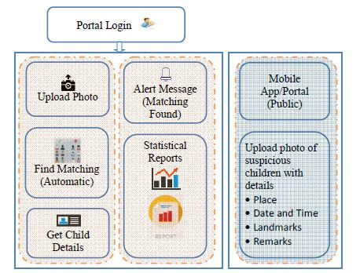
ARCHITECTURE DIAGRAM

Slide 10

LIST OF MODULES
Official
Public
Identification

Slide 11
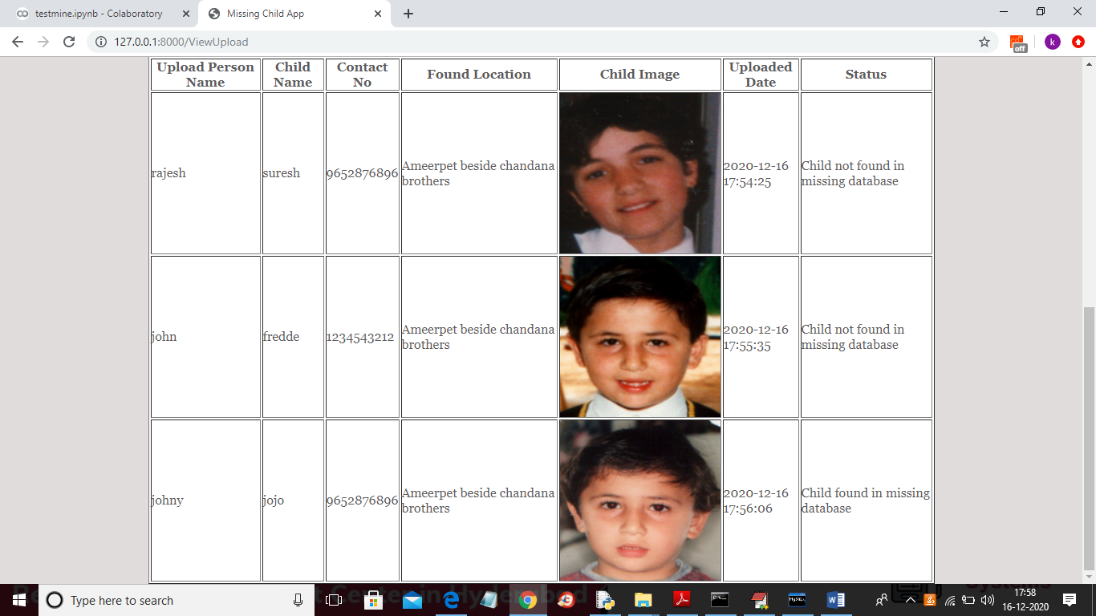
Expected Outcome/Result

Slide 12
REFERENCES
[1] Y. LeCun, Y. Bengio, and G. Hinton, "Deep learning", Nature, 521(7553):436–444, 2015.
[2] O. Deniz, G. Bueno, J. Salido, and F. D. la Torre, "Face recognition using histograms of oriented gradients", Pattern Recognition Letters, 32(12):1598–1603, 2011.
[3] C. Geng and X. Jiang, "Face recognition using sift features", IEEE International Conference on Image Processing(ICIP), 2009.
[4] Rohit Satle, Vishnuprasad Poojary, John Abraham, Shilpa Wakode, "Missing child identification using face recognition system", International Journal of Advanced Engineering and Innovative Technology (IJAEIT), Volume 3 Issue 1 July - August 2016.

Slide 13
THANK YOU

